Slide 1



Kentico Cloud & JavaScript
Ondřej Chrastina

Slide 2
Introduction
Topic: Introduce current JavaScript repositories around Kentico Cloud and show how to start start with exploring the new JavaScript technologies.
Purpose/Problem addressed: Big psychic barrier to enter the JavaScript word.
Expected Outcome: Know where&how to start with KC & JS word.

Slide 3
Agenda
Repositories walkthough (esp. JS monorepo)
Node.js & npm
React
Vue
Angular
Tests (Jest)

Slide 4
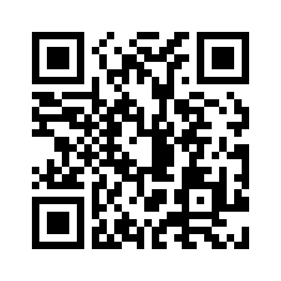





Let‘s dive into code!
...and use StackOverflow and kentico-cloud tag!
@ChrastinaOndrej
@Simply007
@Simply007
ondrejchrastina
https://github.com/Simply007/BrmoSample

